Slide 1

GHG Mitigation Strategies
The Carbon Insight Collective Ltd.
Project 3:
April 22, 2024
Haftom Ermias
Tania Raugewitz
Gabriel Vasquez
Cap and Trade Analysis
Notes:
Hello and welcome to our final series on Greenhouse Gas Mitigation Strategies

Slide 2
Executive Summary & Overview
Tania
Summary and Project Overview
Data Sourcing and Approach
Results and Conclusions
Interactive Technology
Final Take Away
Notes:
Our final series is focused on a policy known as Cap and Trade:Analzying the Effectiveness of Cap and Trade is divided into 5 main segments:
I will start us out by briefly explaining this policy and how it works.
Next, Haftom will explain our approach to organizing, compiling, and analyzing the data
In “the results and conclusions section”, we answer our initial question: Is Cap and Trade an effective strategy for mitigating GHGs.
New and exciting to this presentation is our interactive chat bot. Gabe will guide us through this piece.
As always , we will end our presentation with a Q & A session.

Slide 3
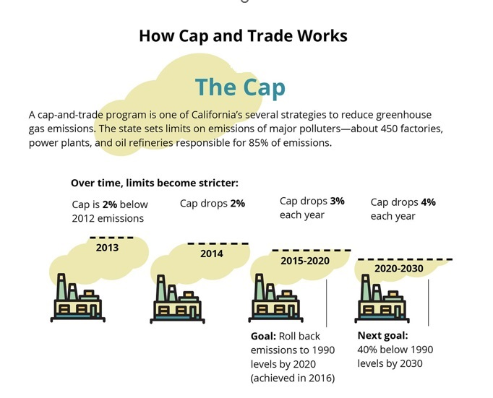
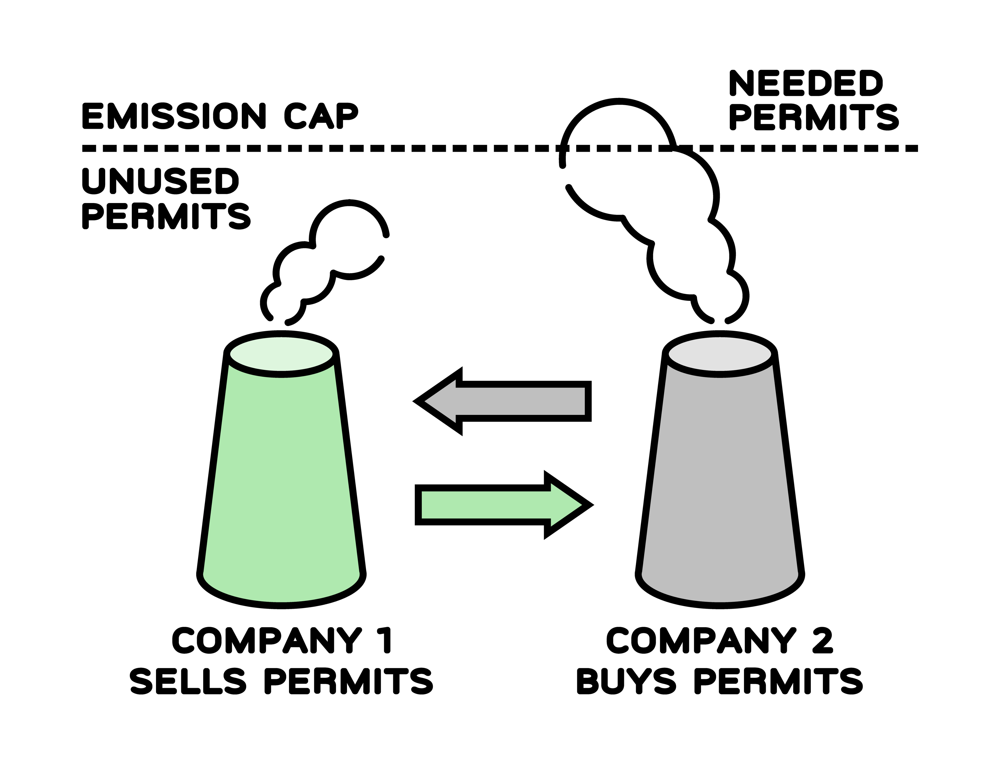
Cap and Trade
Tania
Industries are capped with a reduction every year. Companies can sell unused permits to companies that don’t otherwise comply
Notes:
Currently, in the US, 10 States currently have a formal Cap and Trade policy:
California and 9 states in the northwest region of the US.
Cap and trade starts with an initial Cap on GHG emissions. Every year, that cap drops a certain %. In California, for example, they have designed the program to drop a specific amount. (Read the caption)

Slide 4
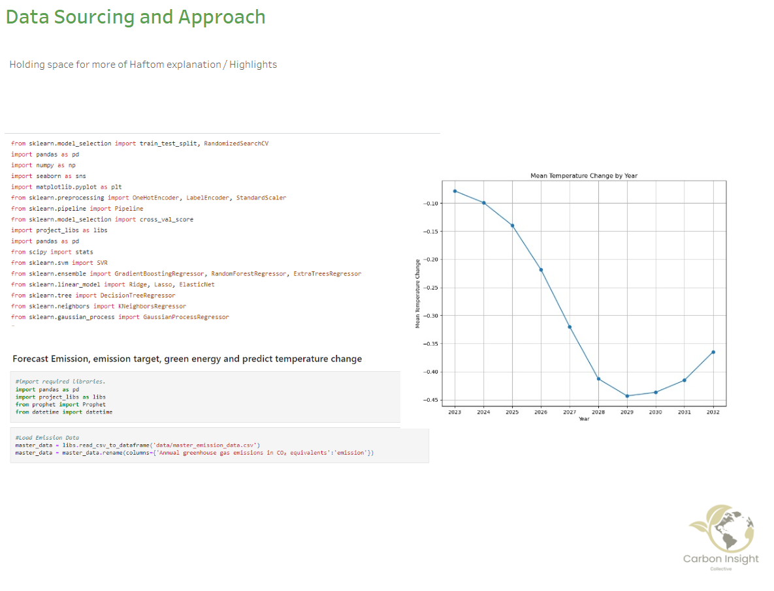
Data Sourcing and Approach
Haftom
Open AI Model Agents
Time Series Forecasting
Data Visualization with Tableau
Gradio Application
Notes:
Haftom:
Data Sourcing and Approach
Features used in our presentation:
Open AI Model and Agents: Implement OpenAI-based model to analyze textual data related to climate and energy.
Time Series Forecasting: Use Prophet and other techniques for accurate forecasting of GHG emissions and temperature variations.
Data Visualization: Utilize Tableau for interactive visualizations showcasing GHG trends and correlations with temperature and renewable energy.
Gradio Application: Develop a Gradio app to enable users to interact with our chatbot and PDF reader, exploring relationships between GHG emissions, temperature changes, and renewable energy adoption.

Slide 5
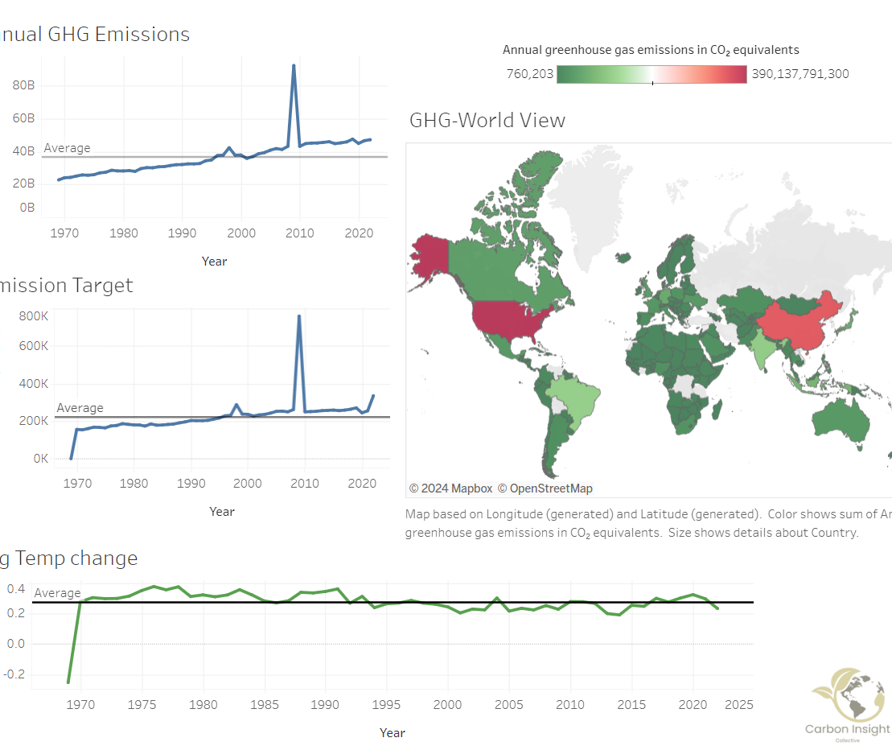
Global View on Emissions, Targets, and Temperature Change
Haftom
Notes:
Global View on Emissions, Targets, Temperature Change

Slide 6
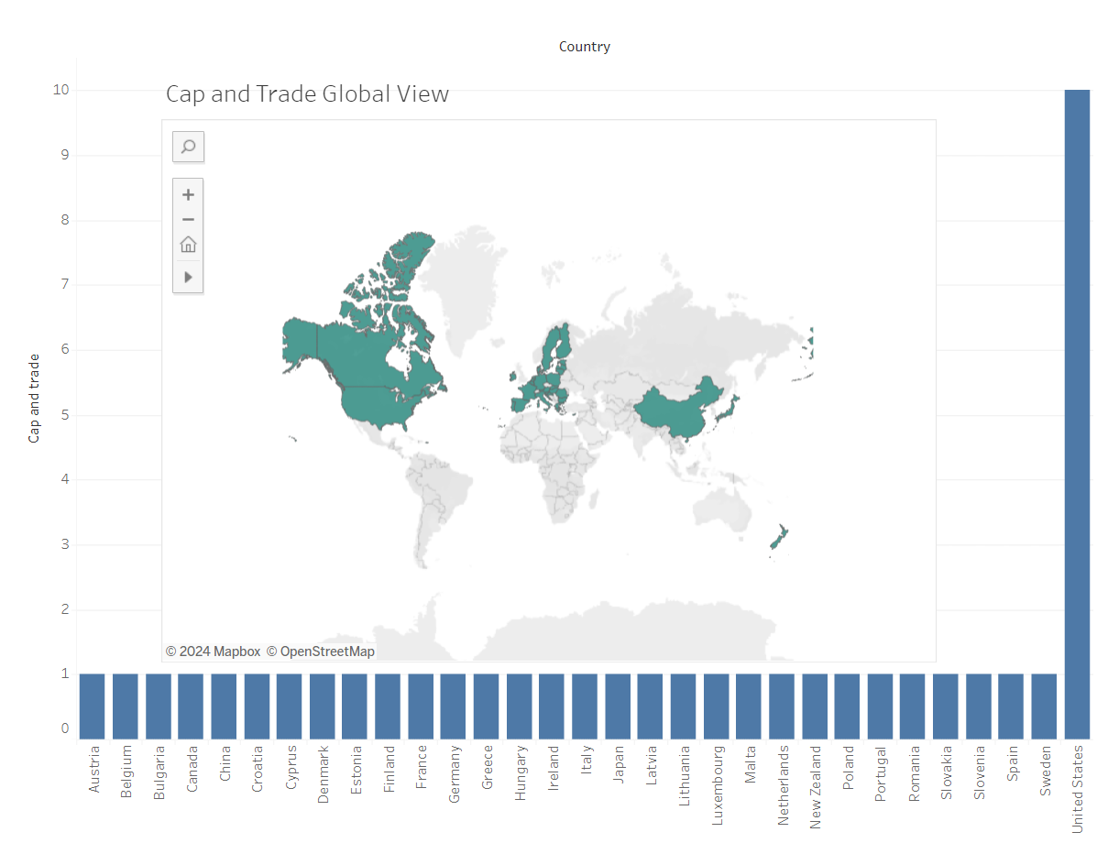
Countries with a Cap and Trade Policy
Haftom / Tania?

Slide 7
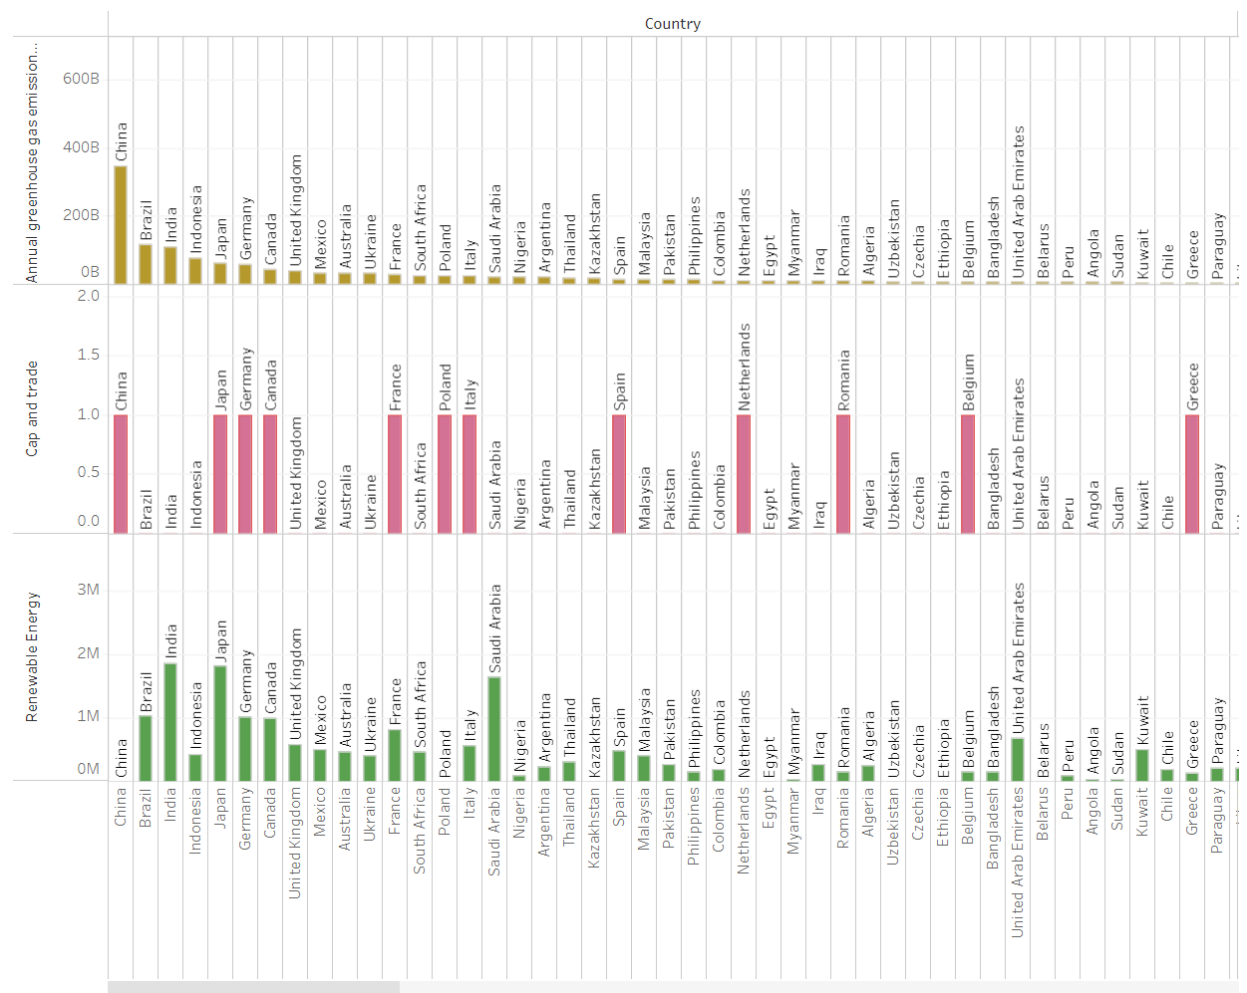
Chart on Renewable Energy, Cap and Trade by Country
Haftom / Tania?

Slide 8

Carbon Insight Collective Interactive Chat Bot
Gabe

Slide 9
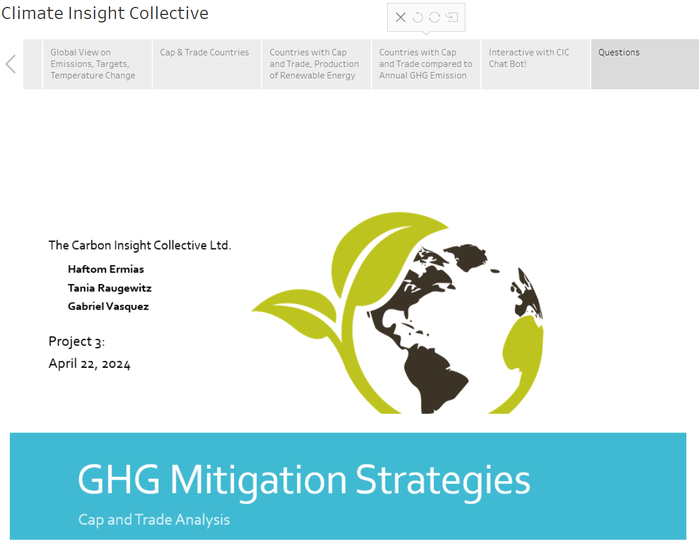
Questions
Gabe

